Slide 1


Handicap Helper
Department of Electrical and Computer Engineering
Instructor: Ming Zhu
Anthony Torres, Gabriel Gabonia, Nathan Pina

Slide 2
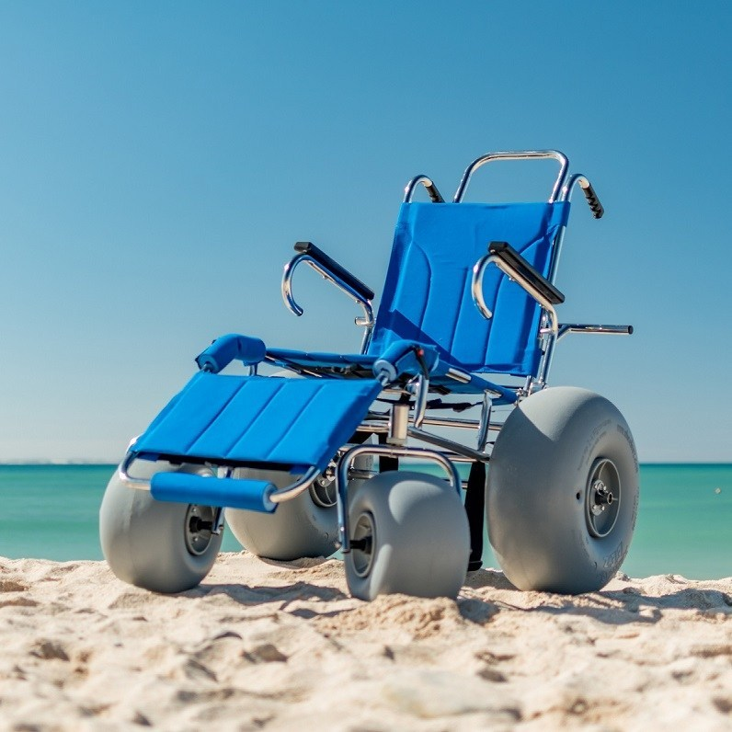
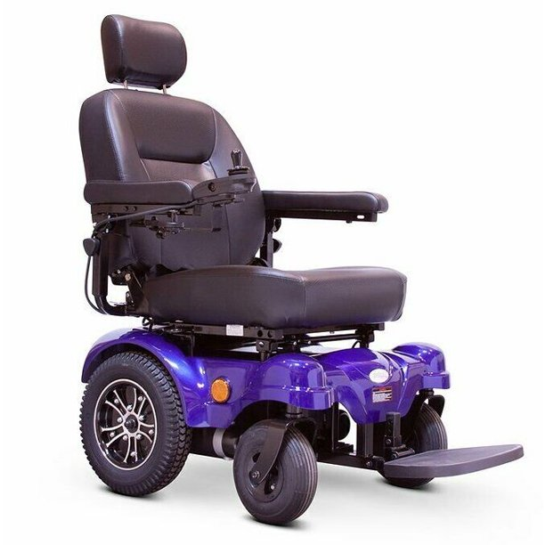
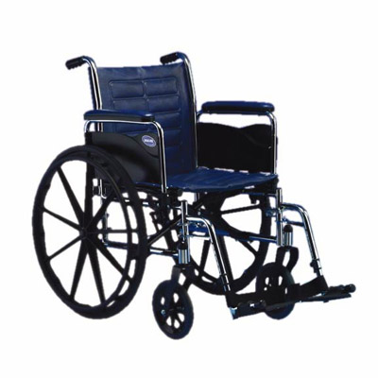
Background and Motivations
Currently there are no automated or autonomous wheelchair retrieval products in the consumer market.
All available solutions require a significant amount of money and material resources as well as the necessity of having a user be present during the entire retrieval process.
The Handicap Helper was designed to assist those with difficulty obtaining their own wheelchair in a safe and hands-free way.

Slide 3
The solution
Situations where the Handicap Helper is needed.
Wheelchair is out of reach or in another room
The wheelchair is too heavy to lift/push for the user
The user is alone and are unable to move the wheelchair themselves
Why is the Handicap Helper a good solution?
The Handicap Helper costs less than $750 to prototype
The Handicap Helper works with manual wheelchairs
The Handicap Helper is autonomous and allows the user to retrieve their chair from a distance
Uses object recognition, spatial awareness and can be manually controlled

Slide 4
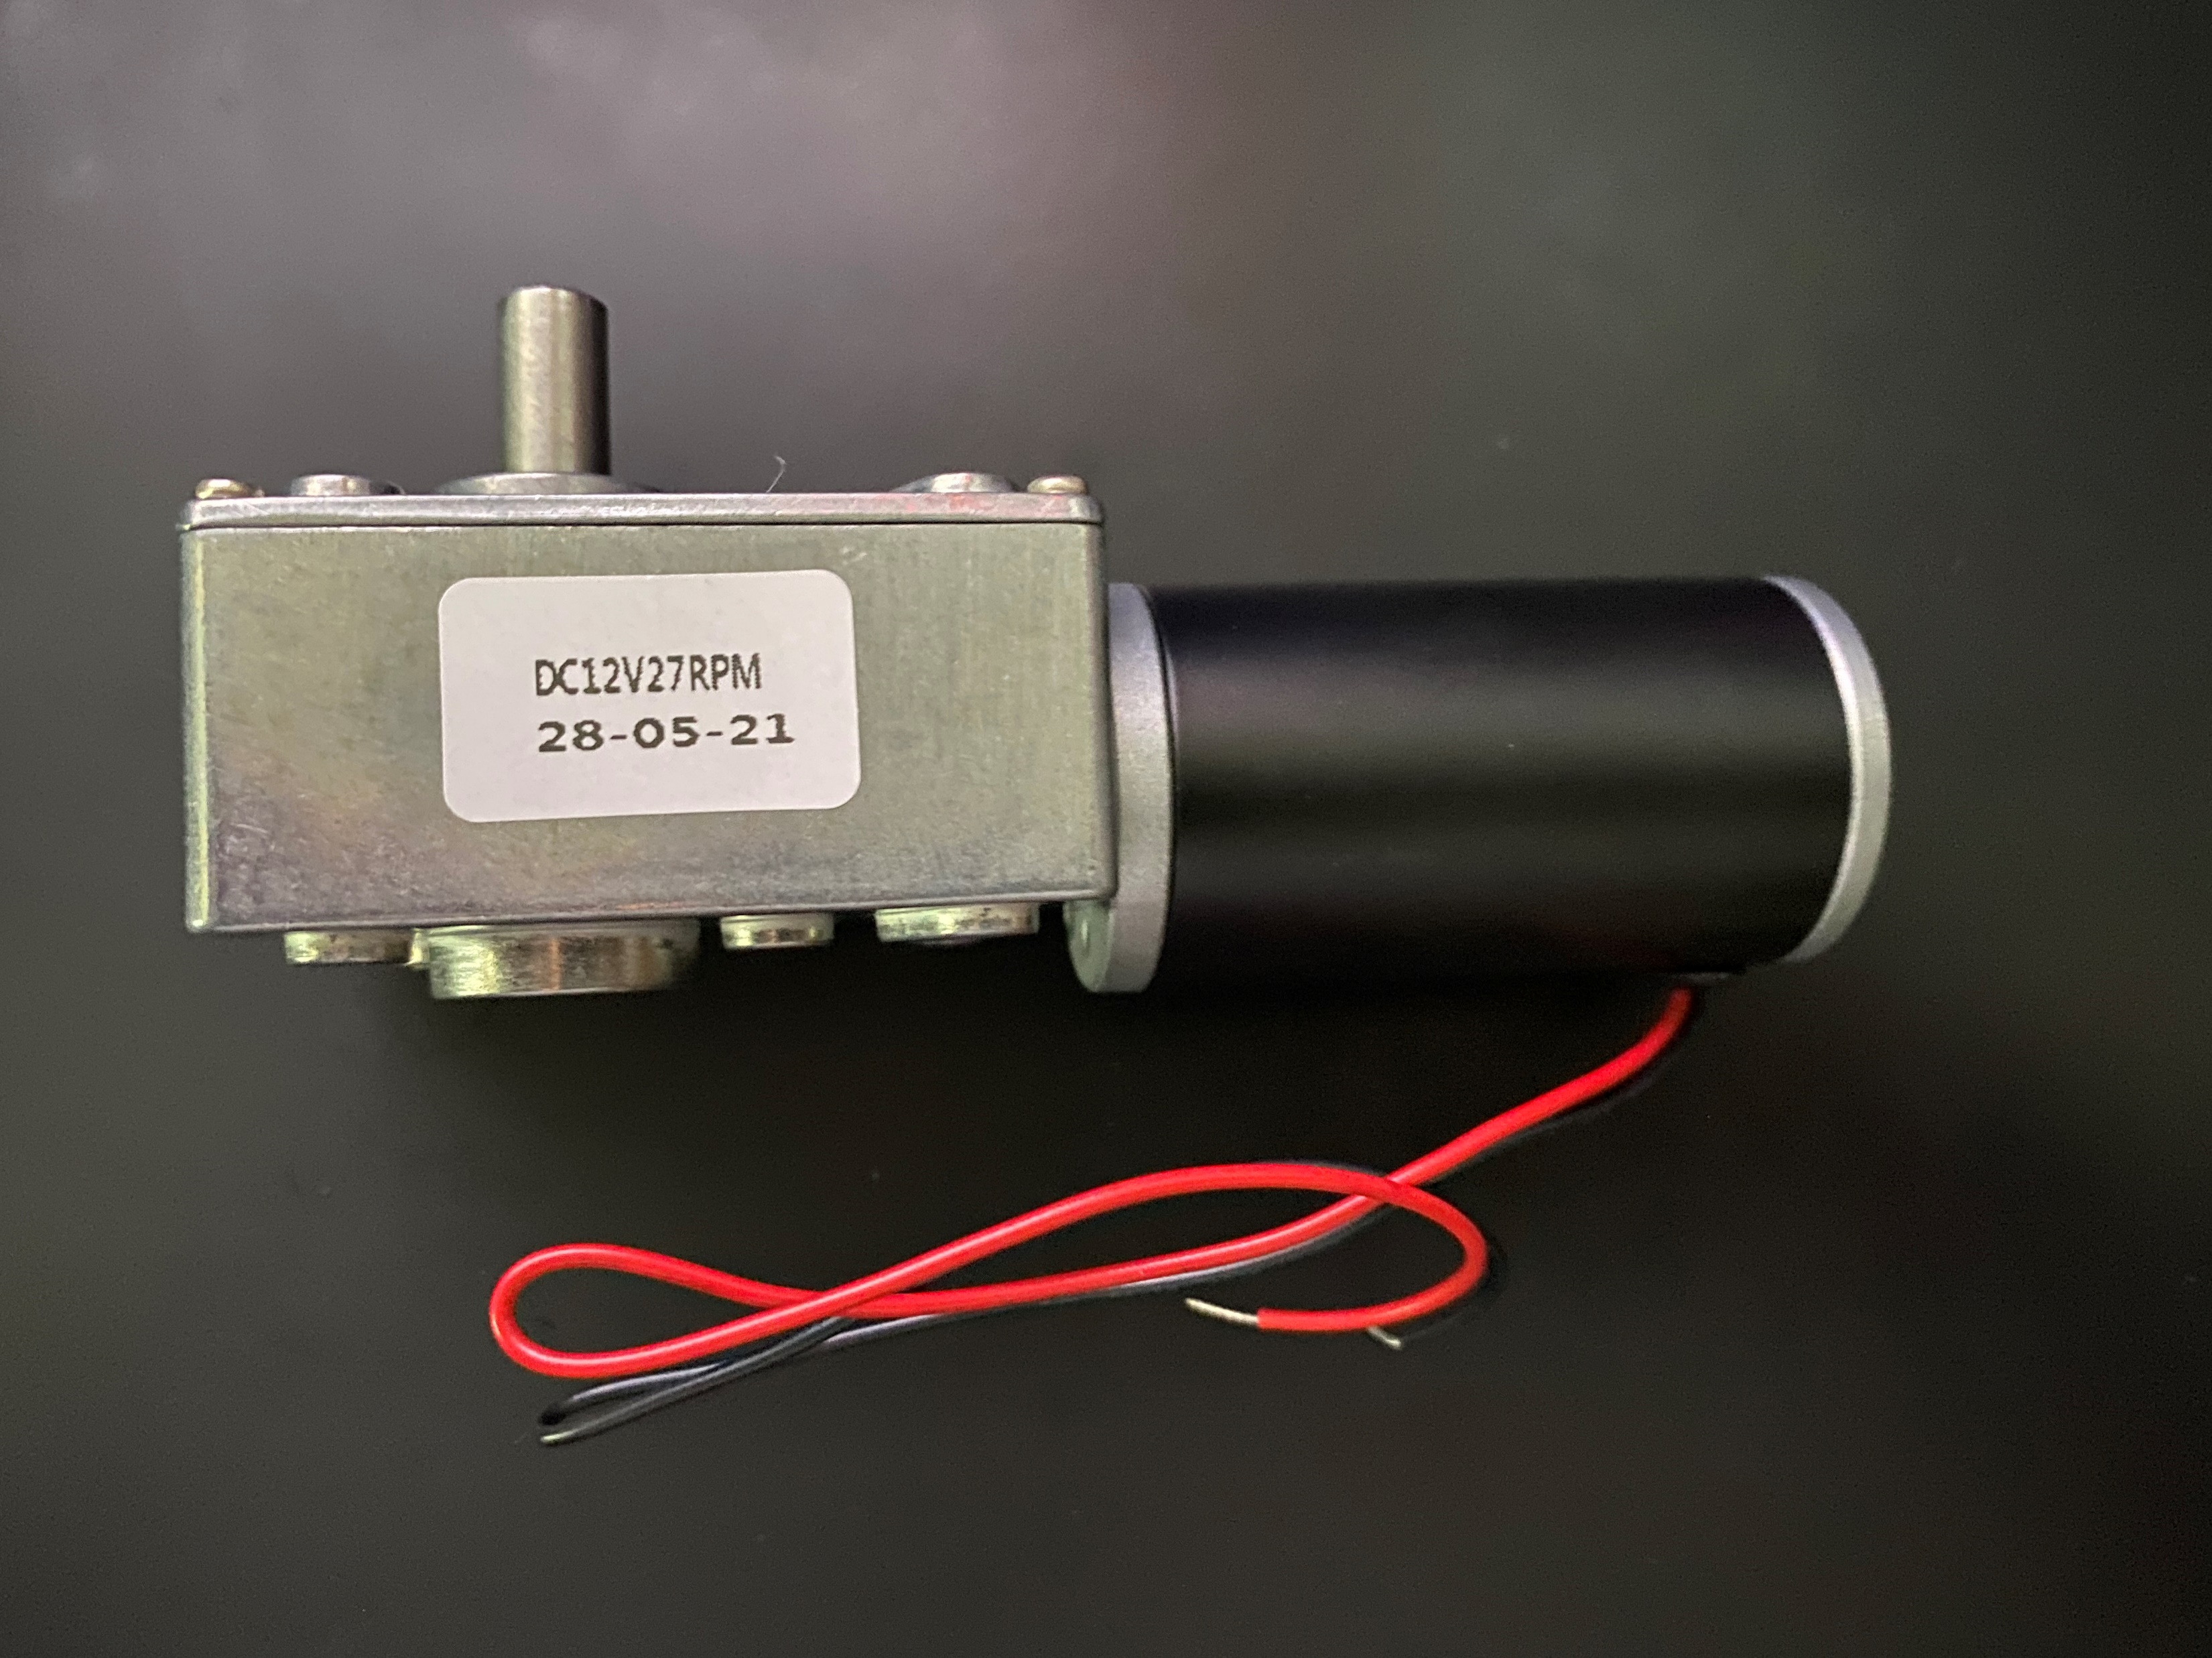
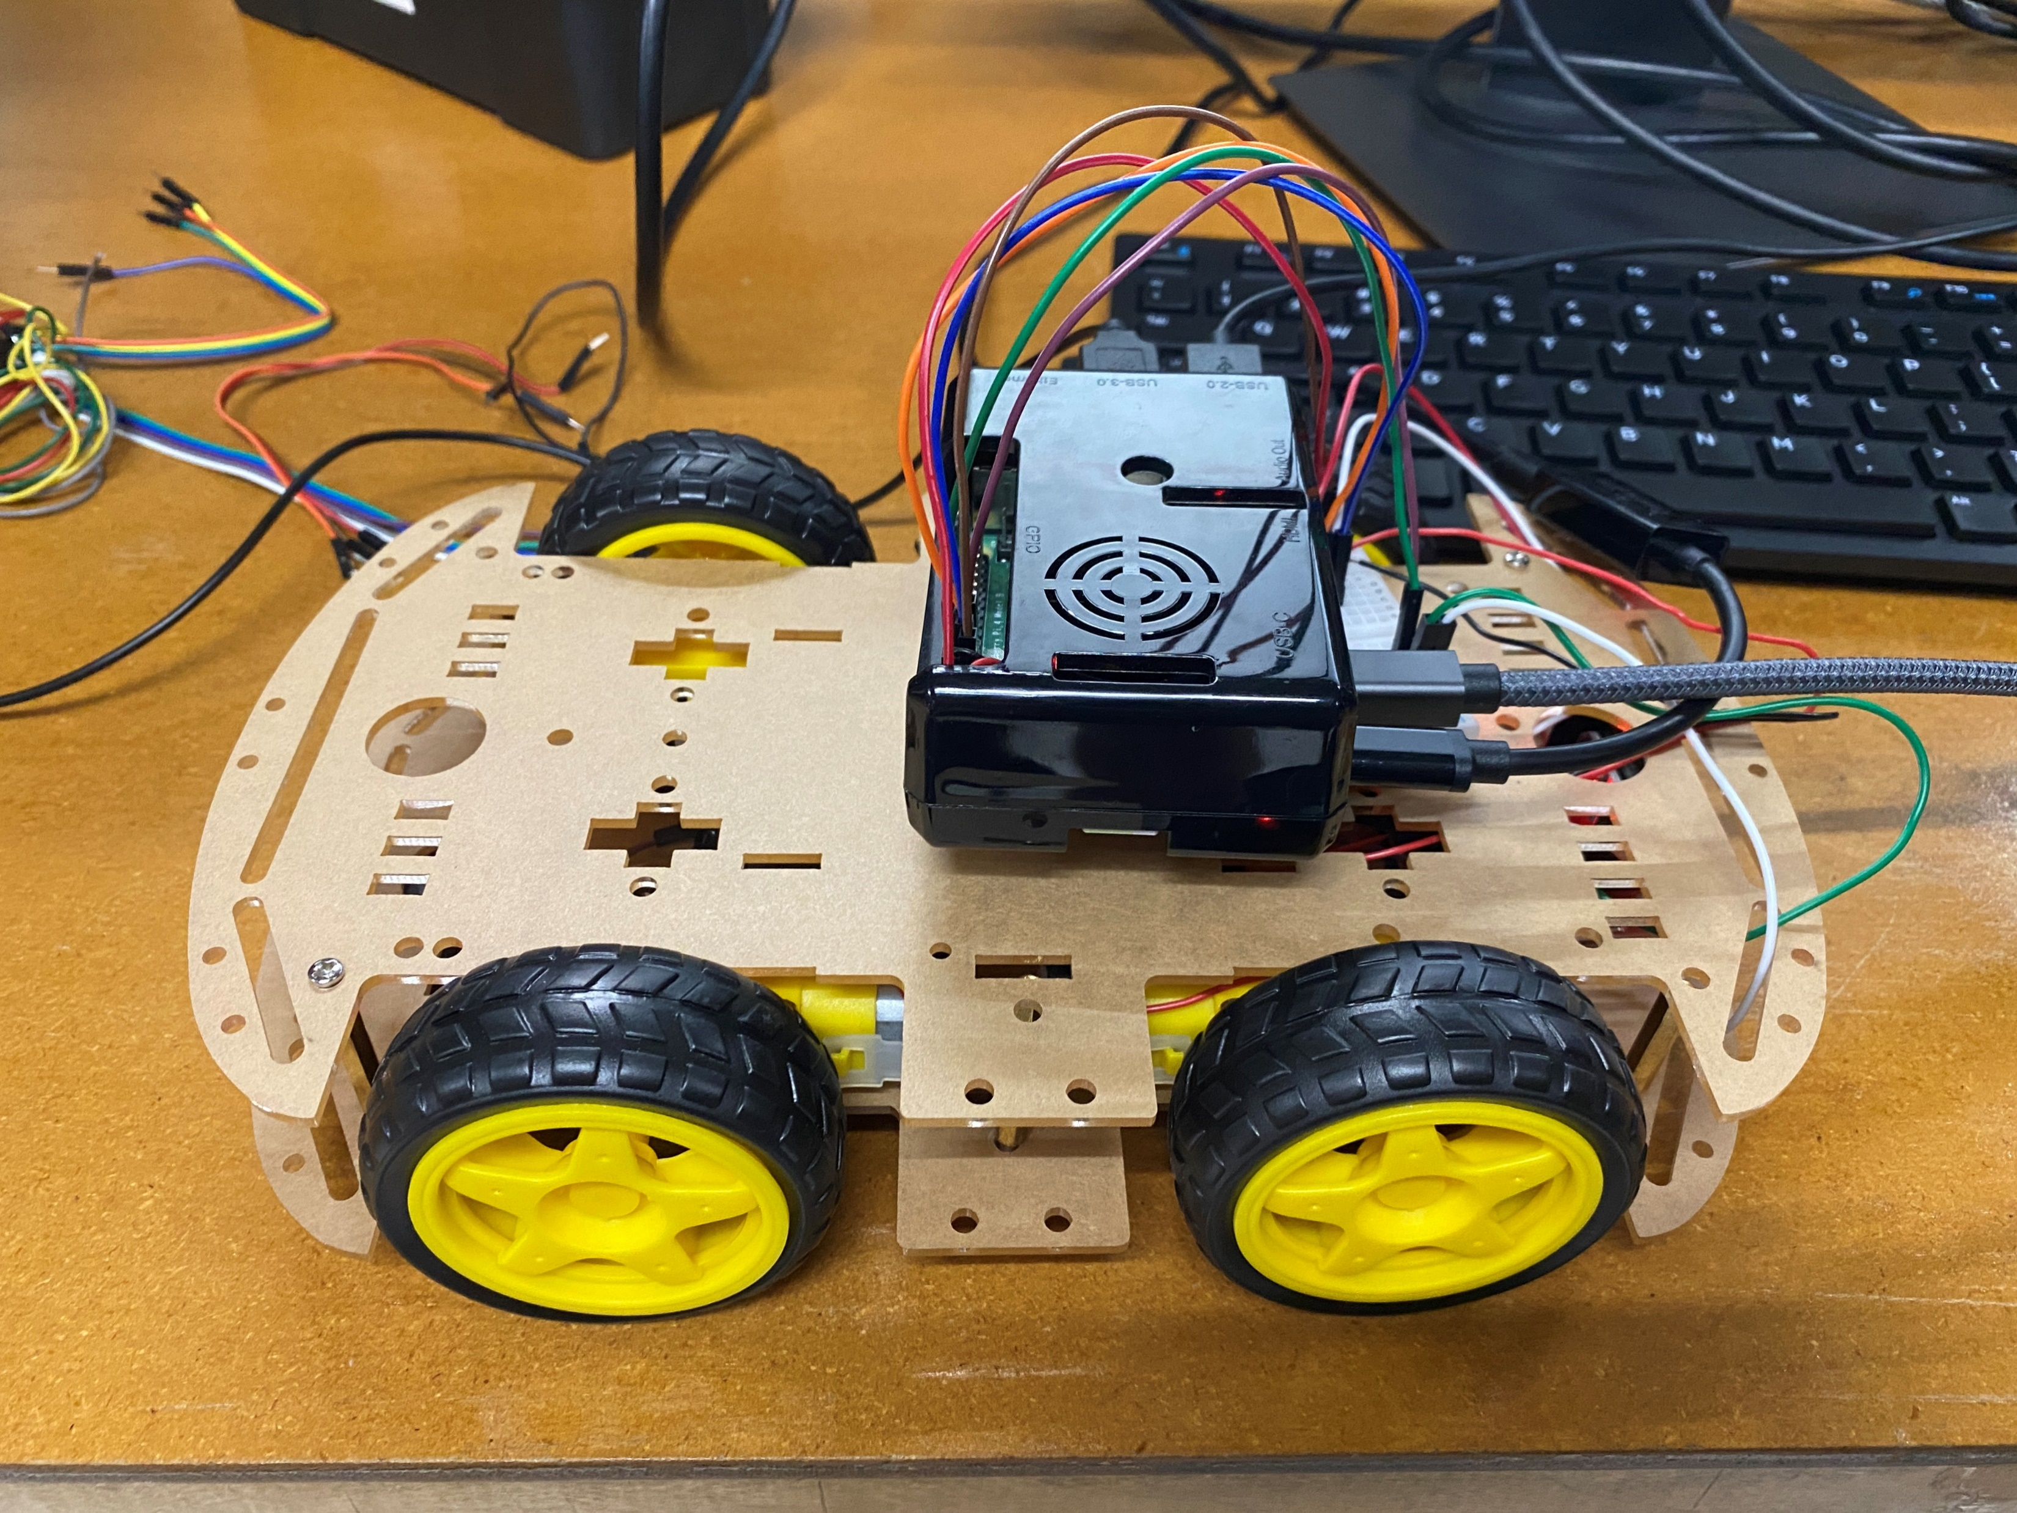
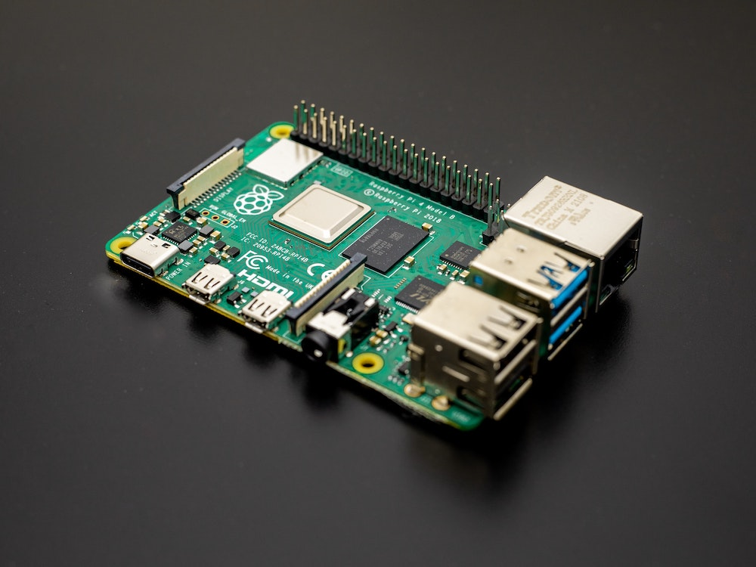
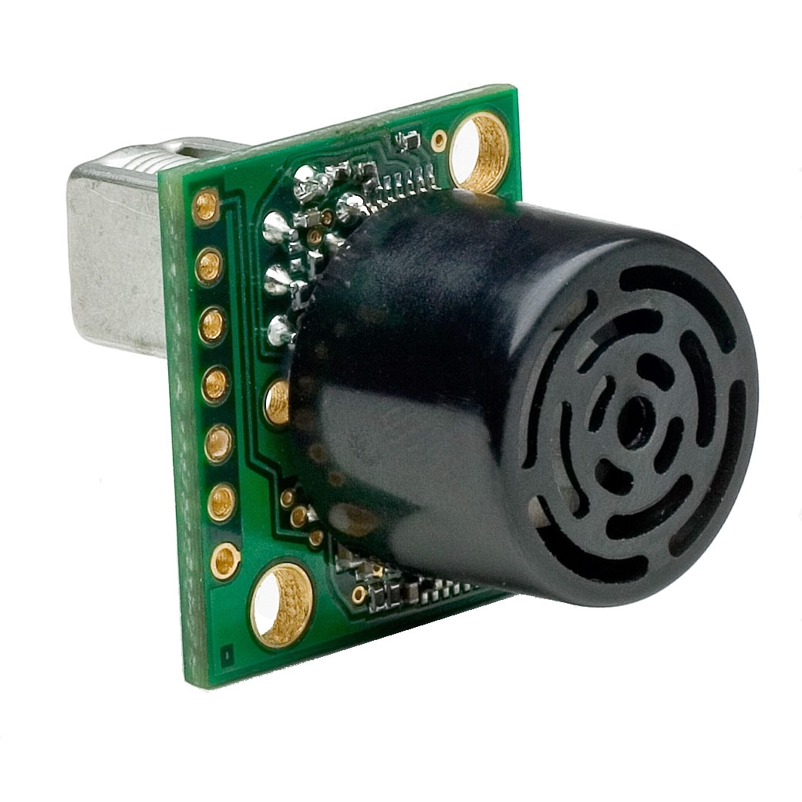
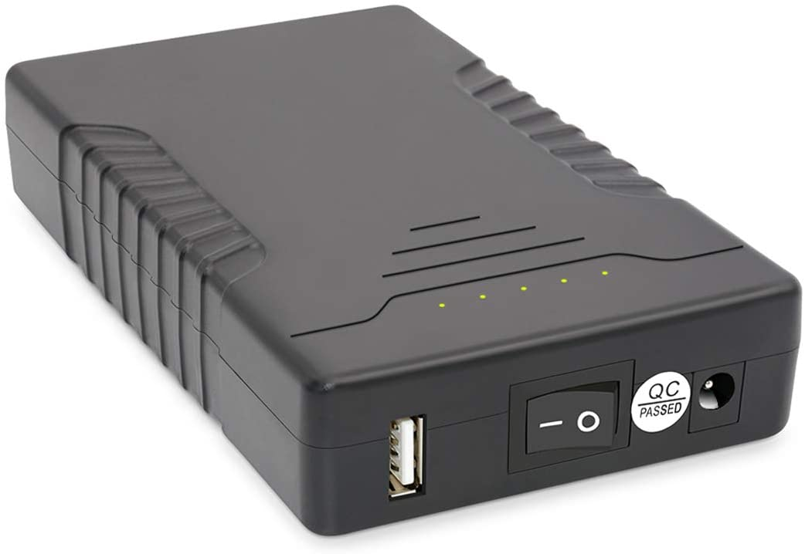
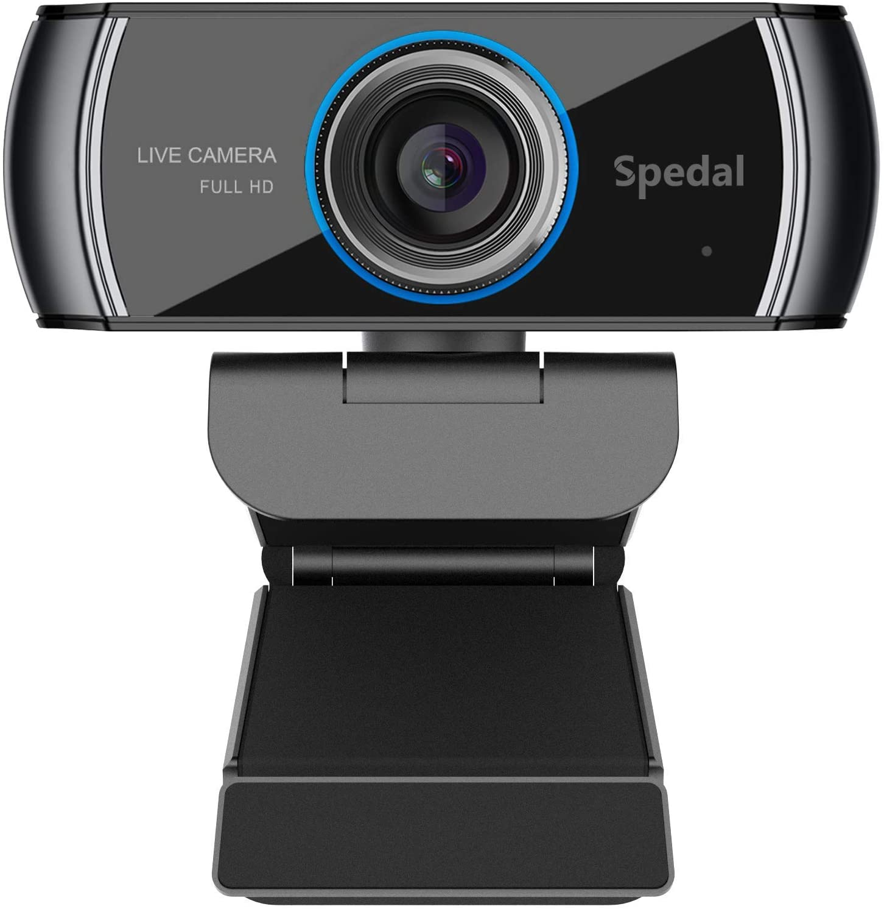
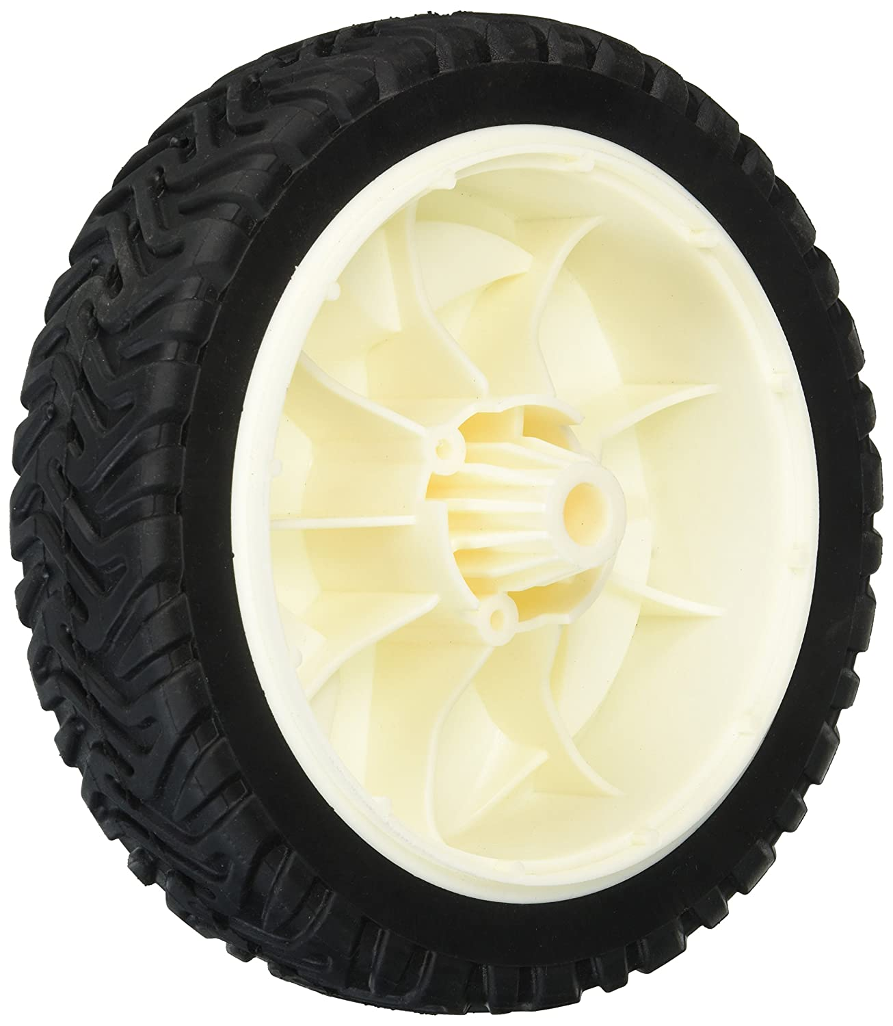
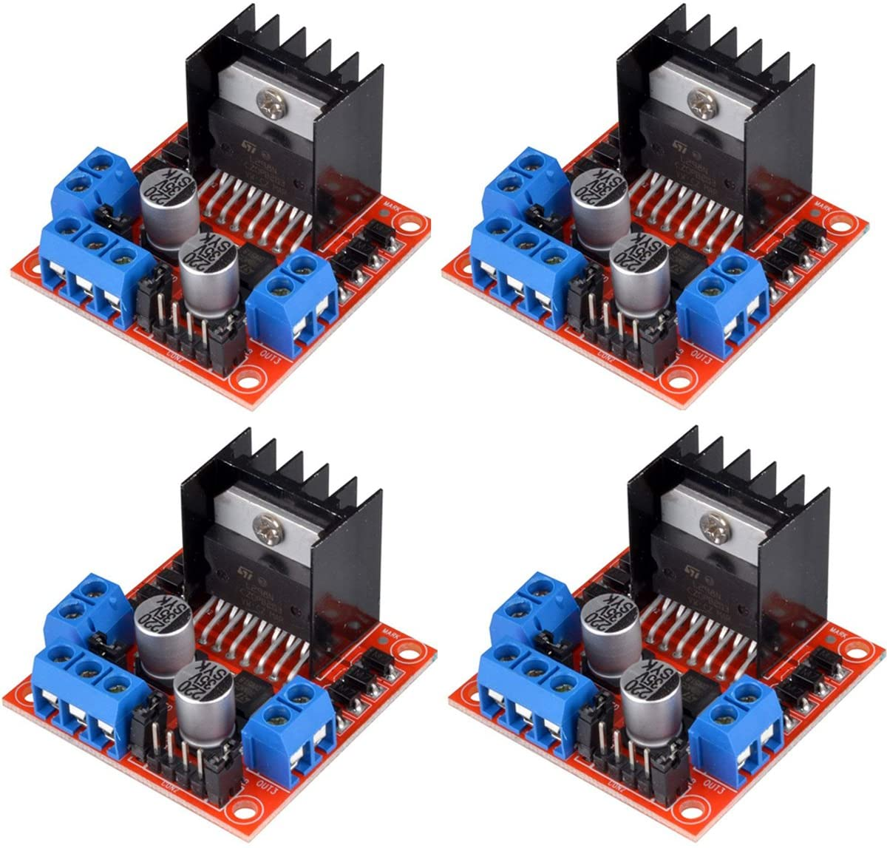
Major parts purchased
High Torque Gear Motor (x4)
CanaKit Raspberry Pi 4 8Gb Ram
Ultrasonic Sensor MB1200 Max Sonar
MakerFocus DIY Robot Car
12V Battery Pack
L298n Motor Drive and Hubs
Webcamera
Wheels

Slide 5
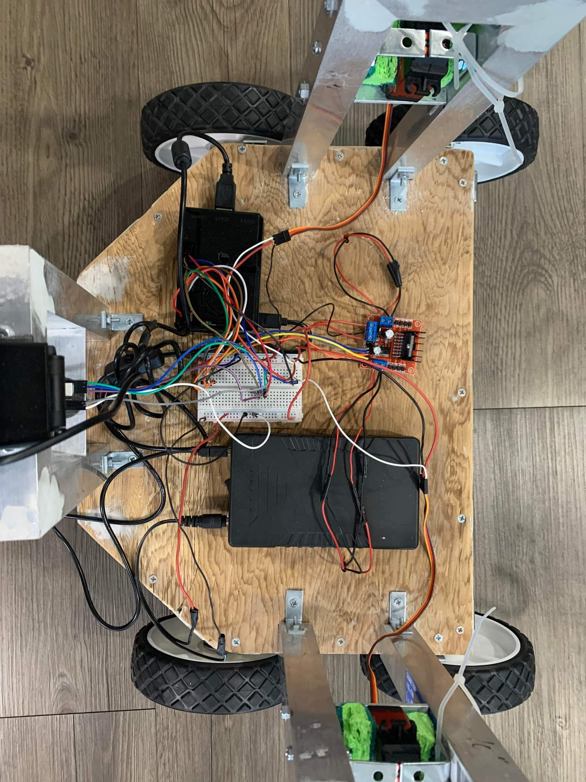
Project Breakdown
Wheelchair Retrieval
Retractable aluminum hooks help pull the wheelchair to the user with the help of high-torque gear motors
Manual Control
Fully controllable with a keyboard in addition to simple and easy to use GUI
Spatial Mapping
Navigation through the user’s room can be done by using predetermined spatial data given to the robot and ultrasonic sensing
Object Detection
Wheelchair is detected by the robot using a mounted camera
Autonomous Driving
Self-driving using ultrasonic sensors, camera, and predetermined mapping of the room

Slide 6
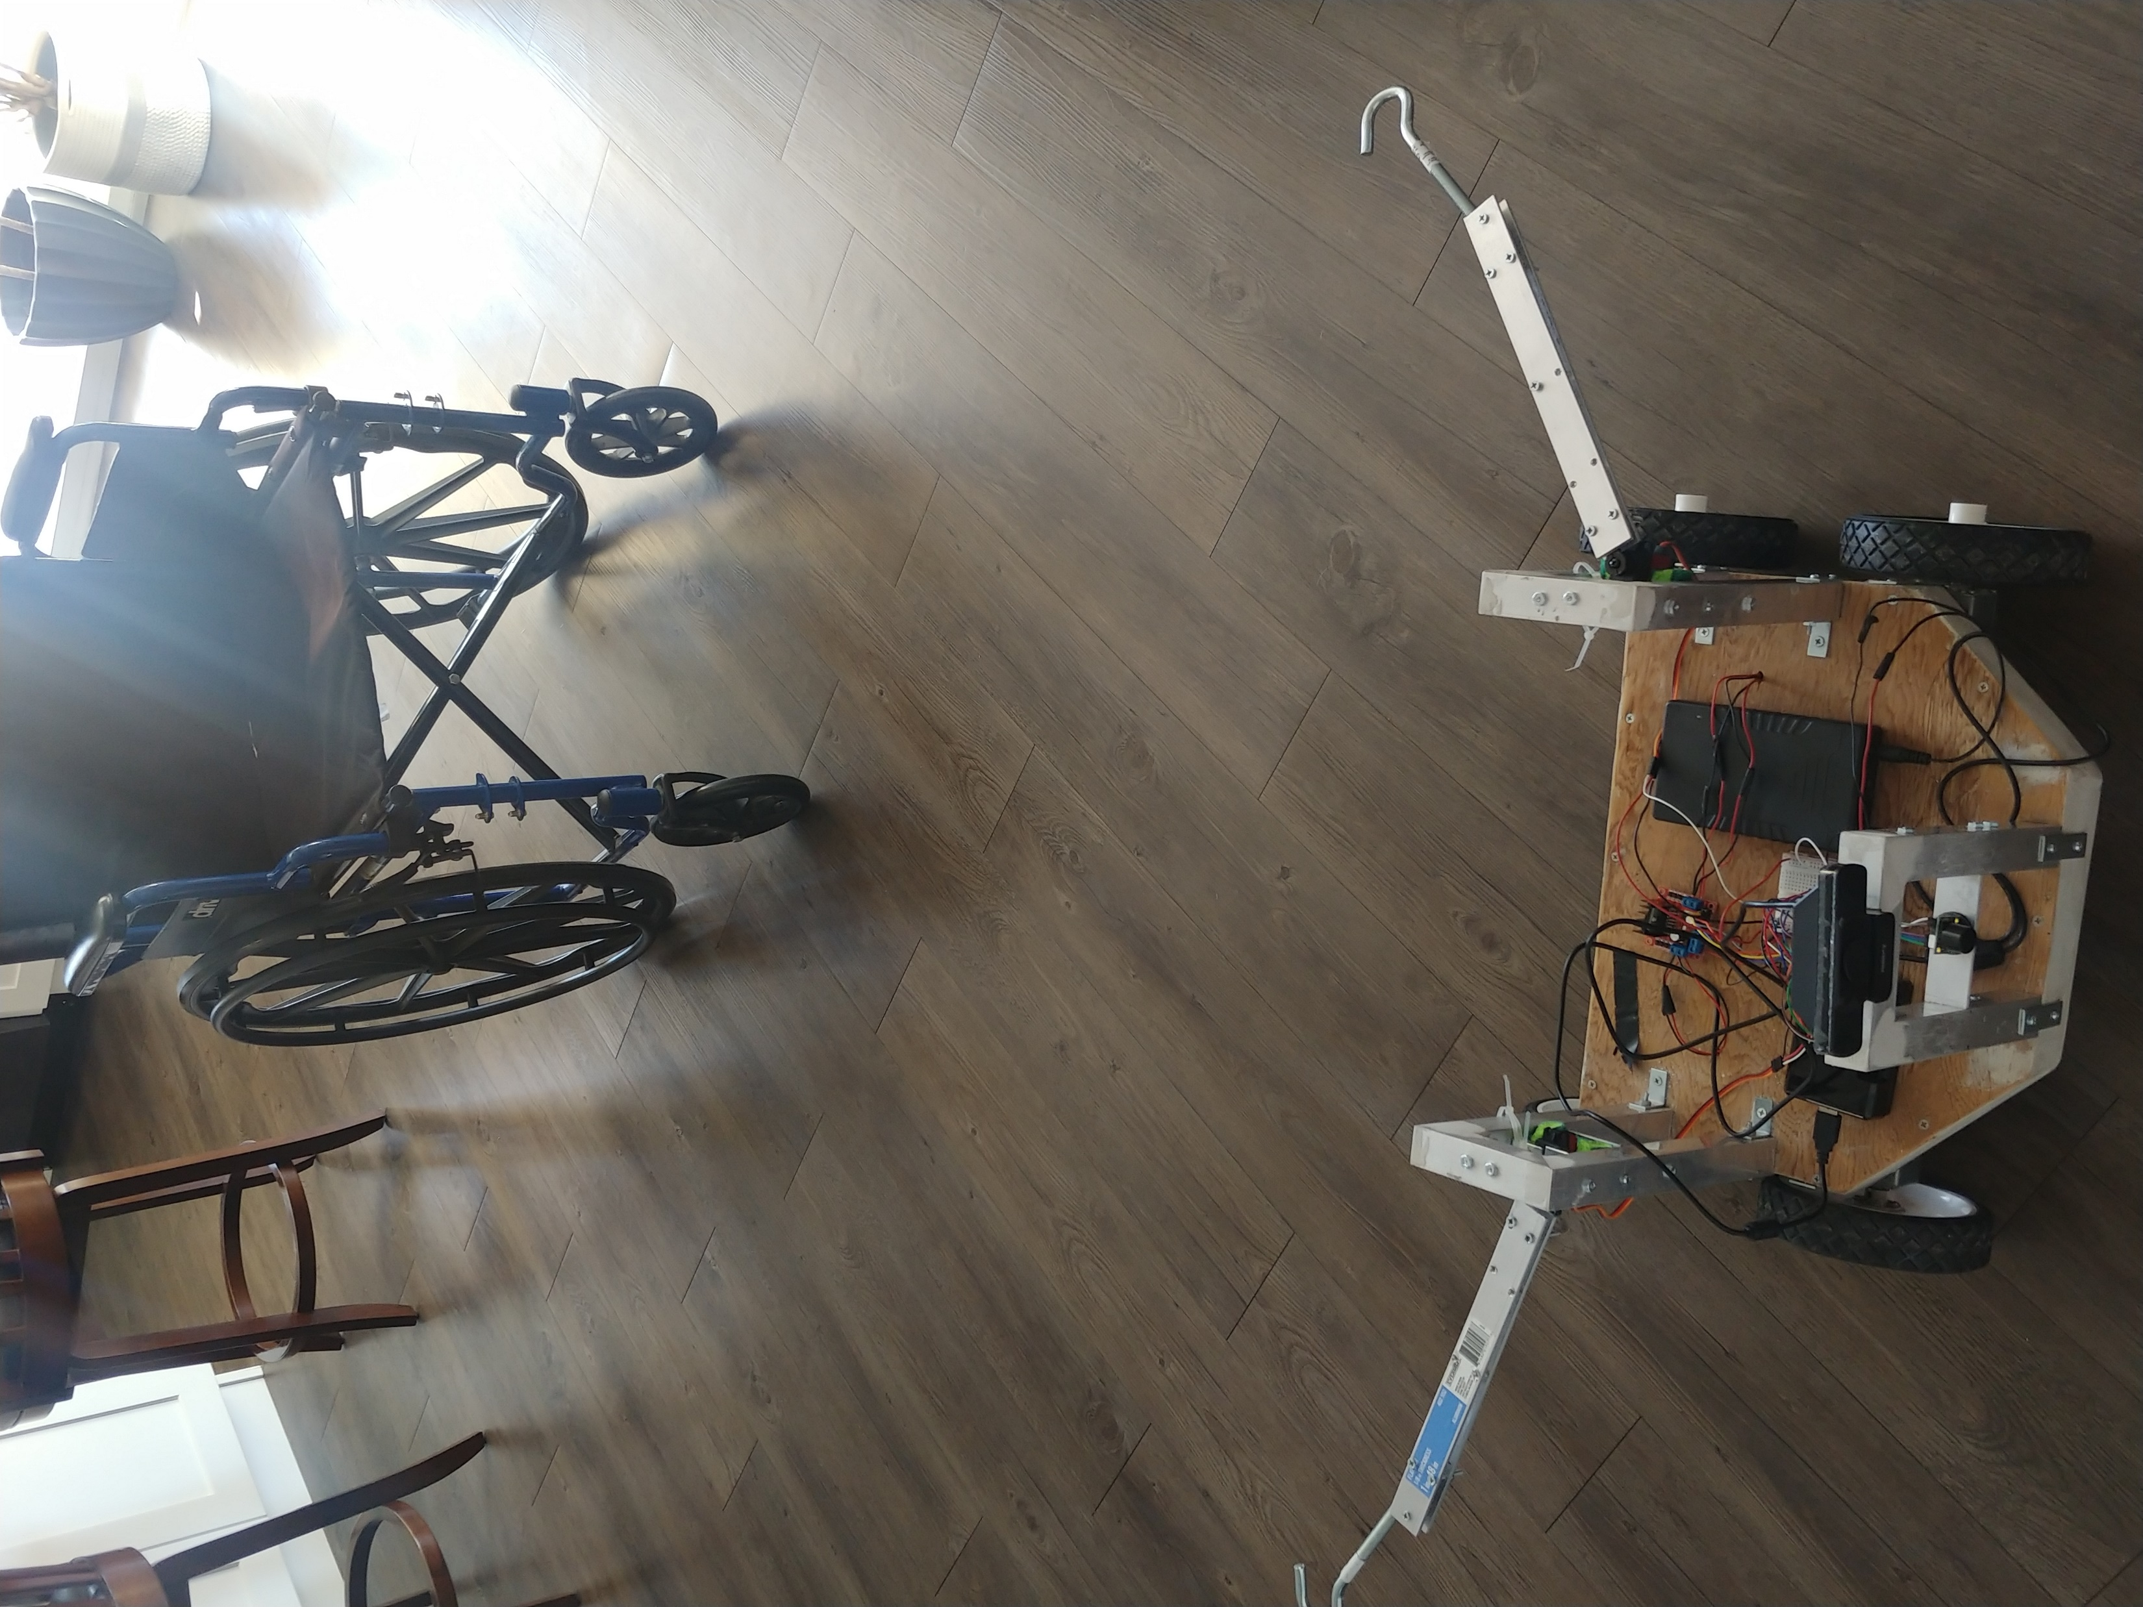
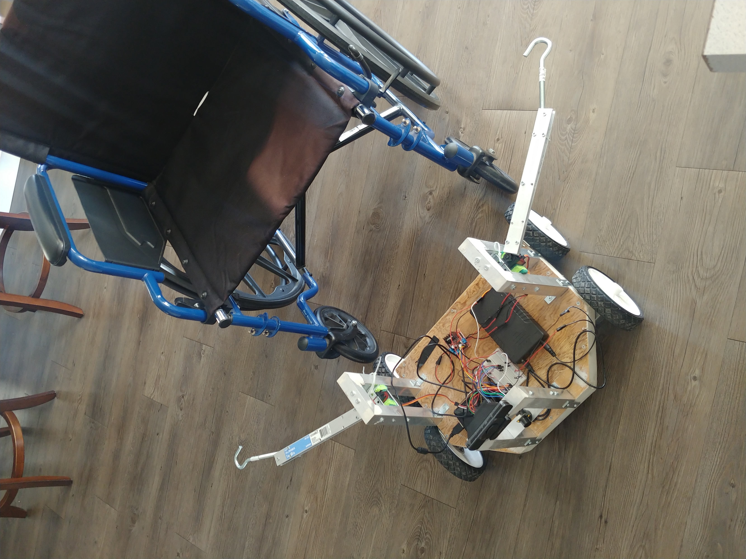
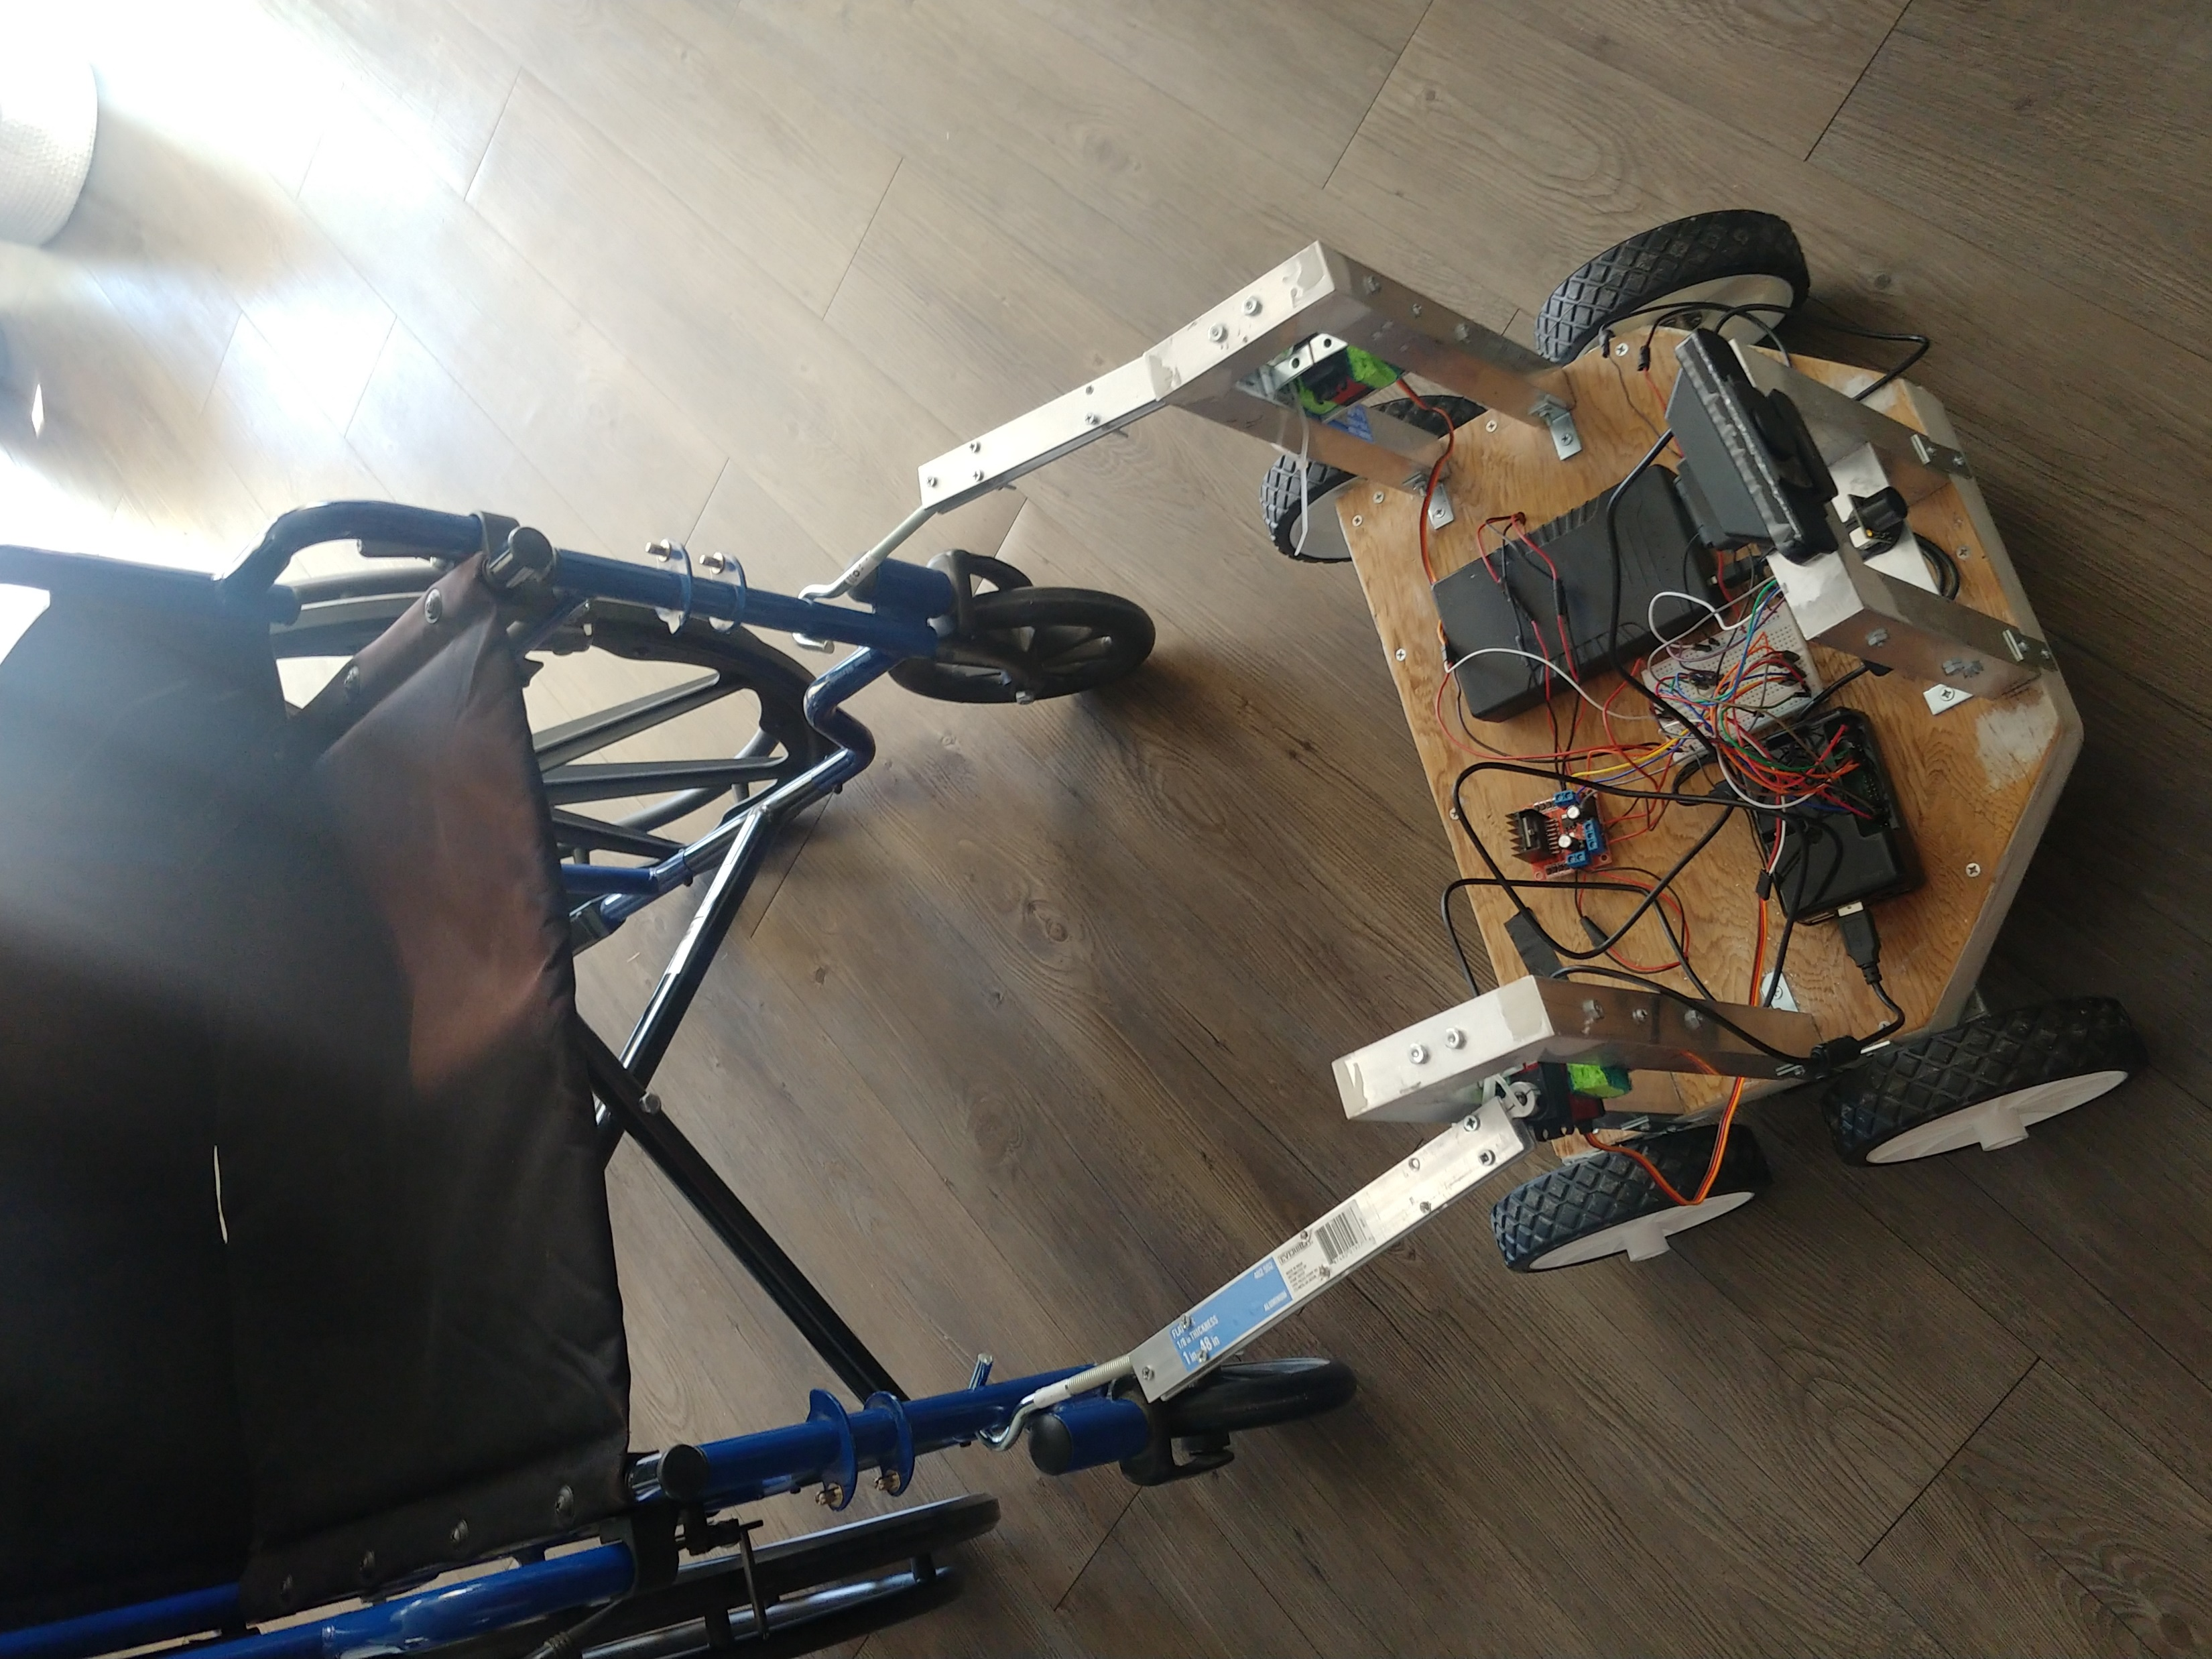
How it works
The basic process of the Handicap Helper can generally be broken down into these steps:
The robot is given a map of the user's room and will look for the wheelchair using its camera
The autonomous driving (or manual driving) will begin as the robot begins to search for the wheelchair
Once located, the robot will position in front of the wheelchair
A set of retractable hooks extend out and latch onto the wheelchair
The robot will then proceed to pull and move the wheelchair back to the user

Slide 7
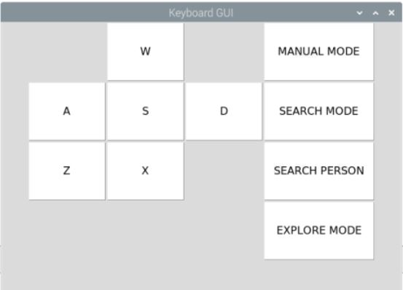
Different Functions
The robot can be set to different settings which can be toggle by the user.
Manual Mode
User takes manual control of the robot with button feedback
Search Mode and Search Person
Robot is set to search for the wheelchair and retrieve it to a person
Explore Mode
Robot will randomly explore the area and avoid obstacles

Slide 8
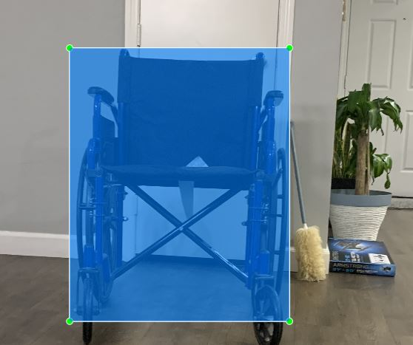
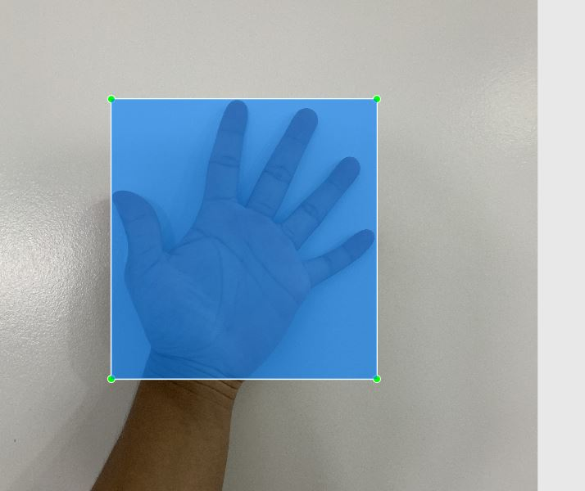
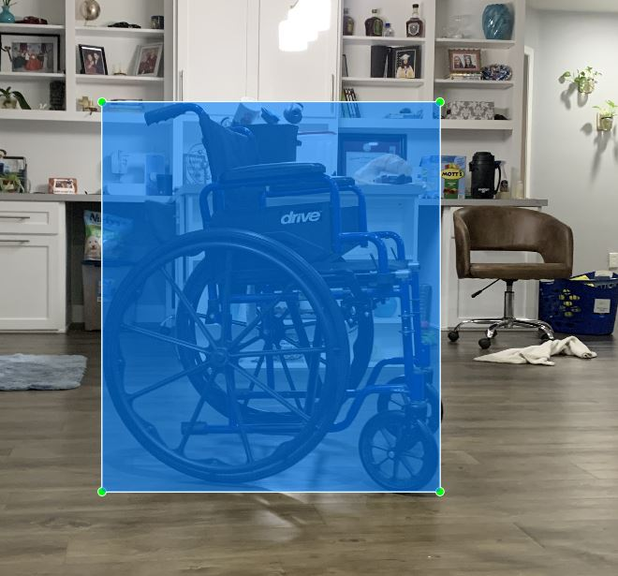
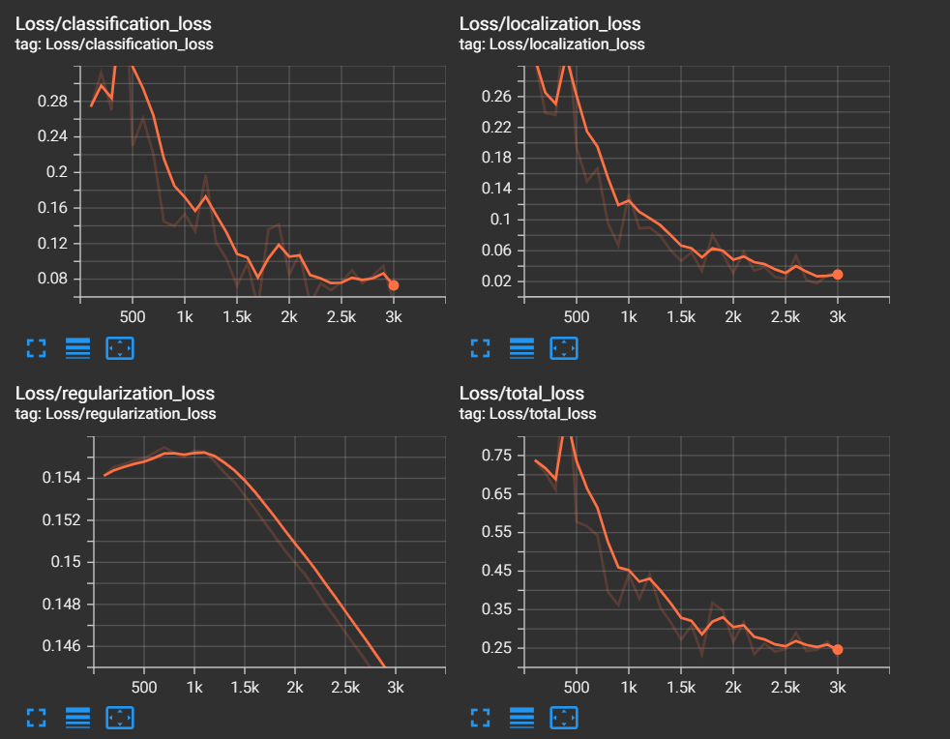
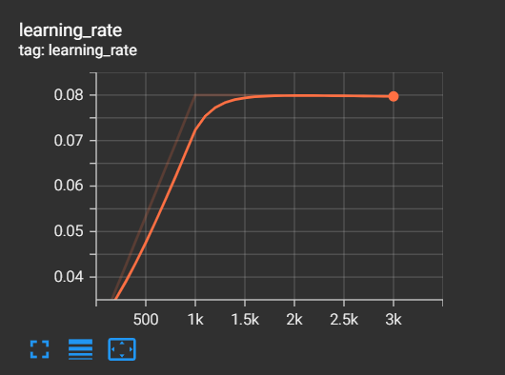
Object Detection
Labelling
First the model had to be trained to see the different sides of the wheelchair. The model had to trained to come to the user through a hand gesture.
The images then go through steps:
Labelling
Machine Learning
Running 4 Different Detections
Ran the Machine Learning Software through 3000 steps
Testing
Machine Learning Data

Slide 9
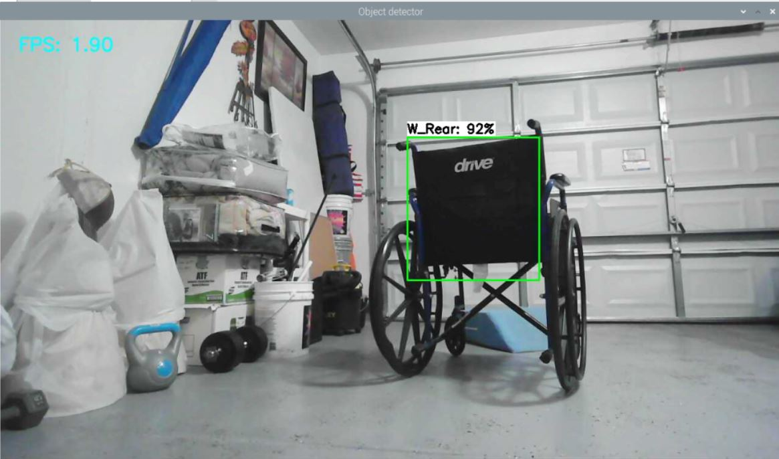
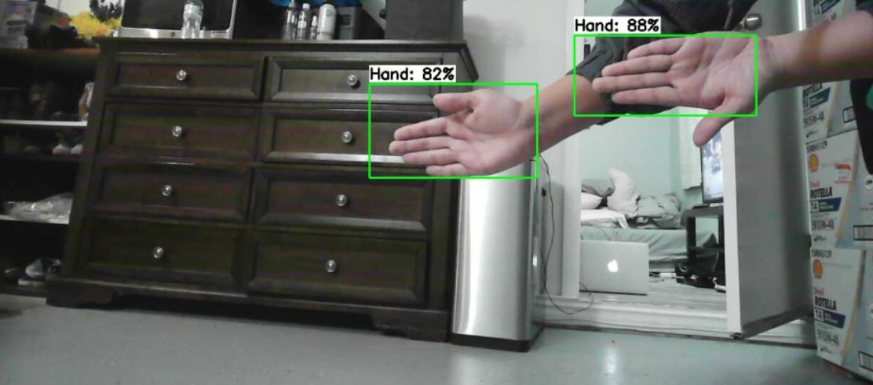
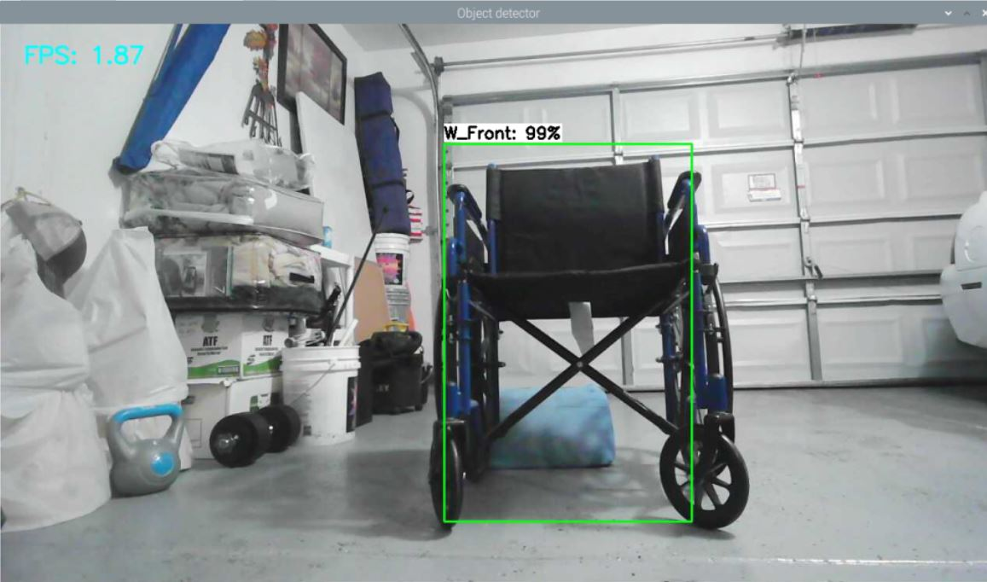
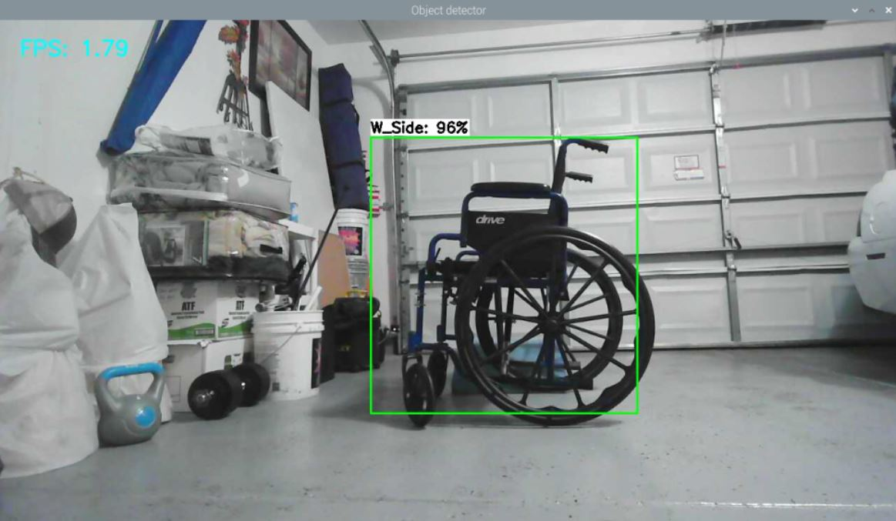
Object Detection Pt. 2

Slide 10
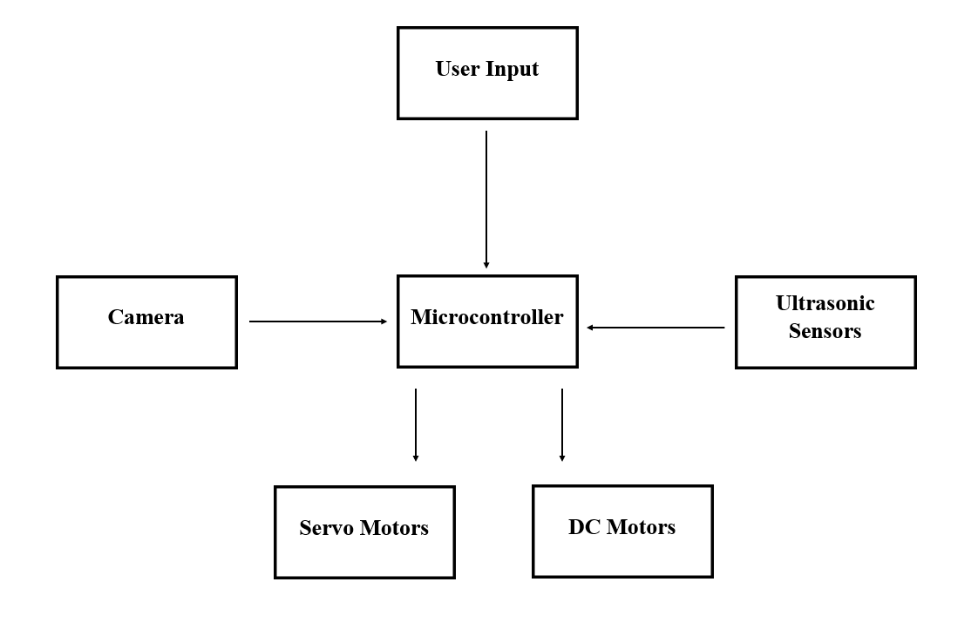
Schematics and design
System Block Diagram
The basic functionality of the Handicap Helper can be broken down into four different sections:
Camera based object detection
Autonomous driving and object avoidance using ultrasonic sensors
Manual movement using high torque DC hear motors
Wheelchair retrieval using and custom hook and servo motor combo
All components will be fed into our microcontroller and Raspberry Pi in addition to the user giving their own input using our custom GUI.

Slide 11
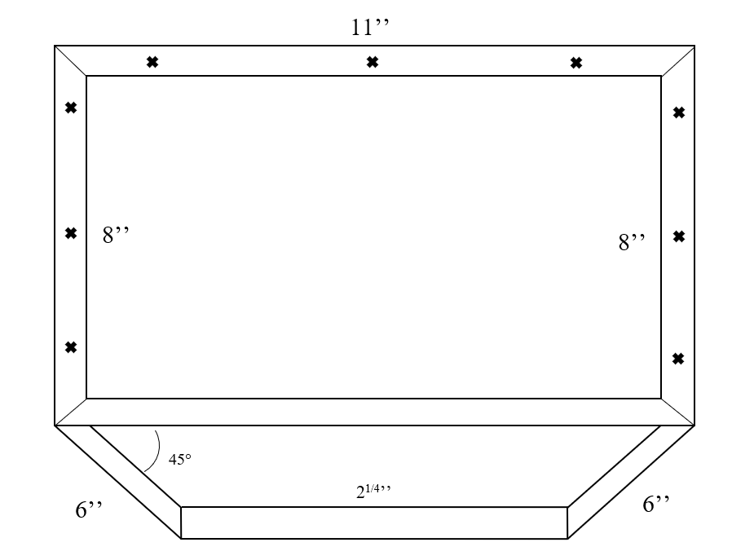
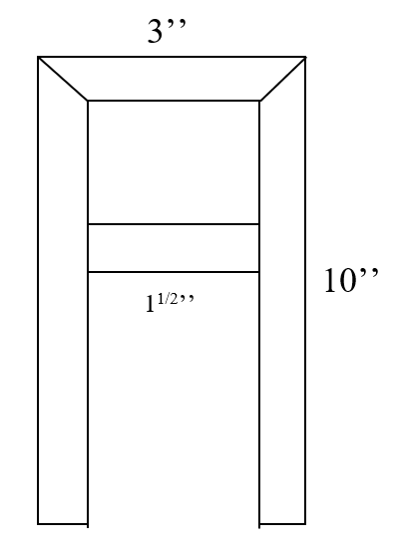
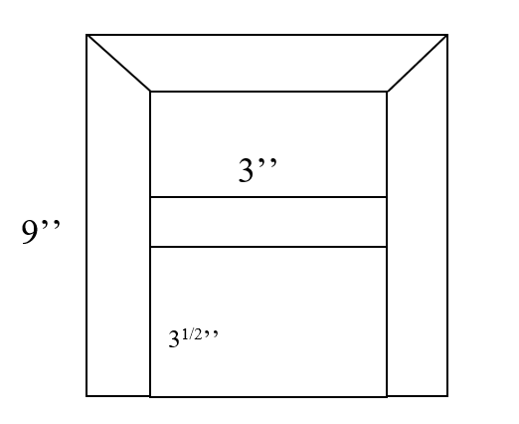
Chassis Design
Top View
The Handicap Helper was designed to be sized universally for all wheelchairs (between 45-60lb).
The main body of the chassis, the retractable hooks, and the main support beams are all made from aluminum
Our electrical components like the Raspberry Pi, external power source, and drive control PCB will all be mounted on a wooden base placed on top of the robot.
Side View
Front View

Slide 12
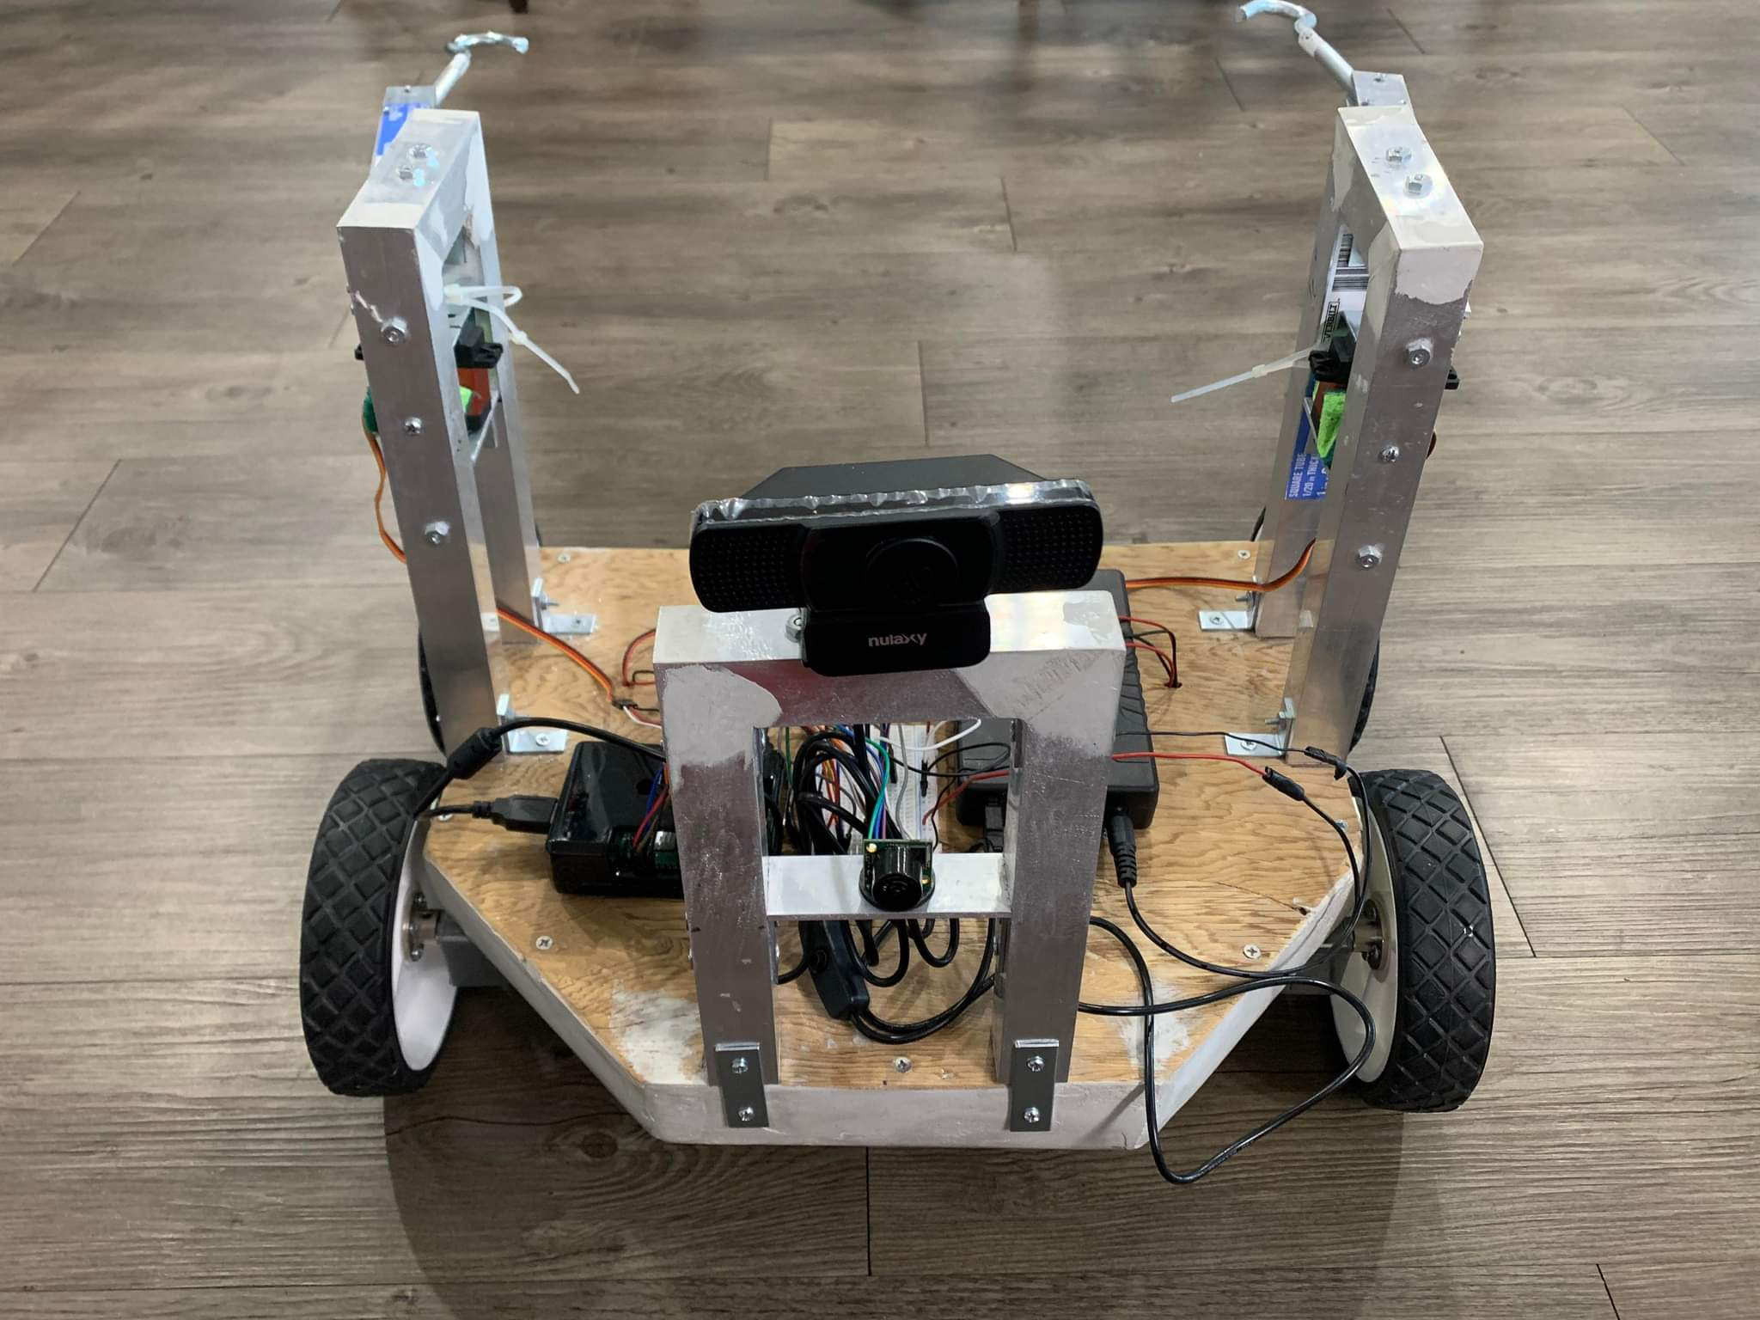
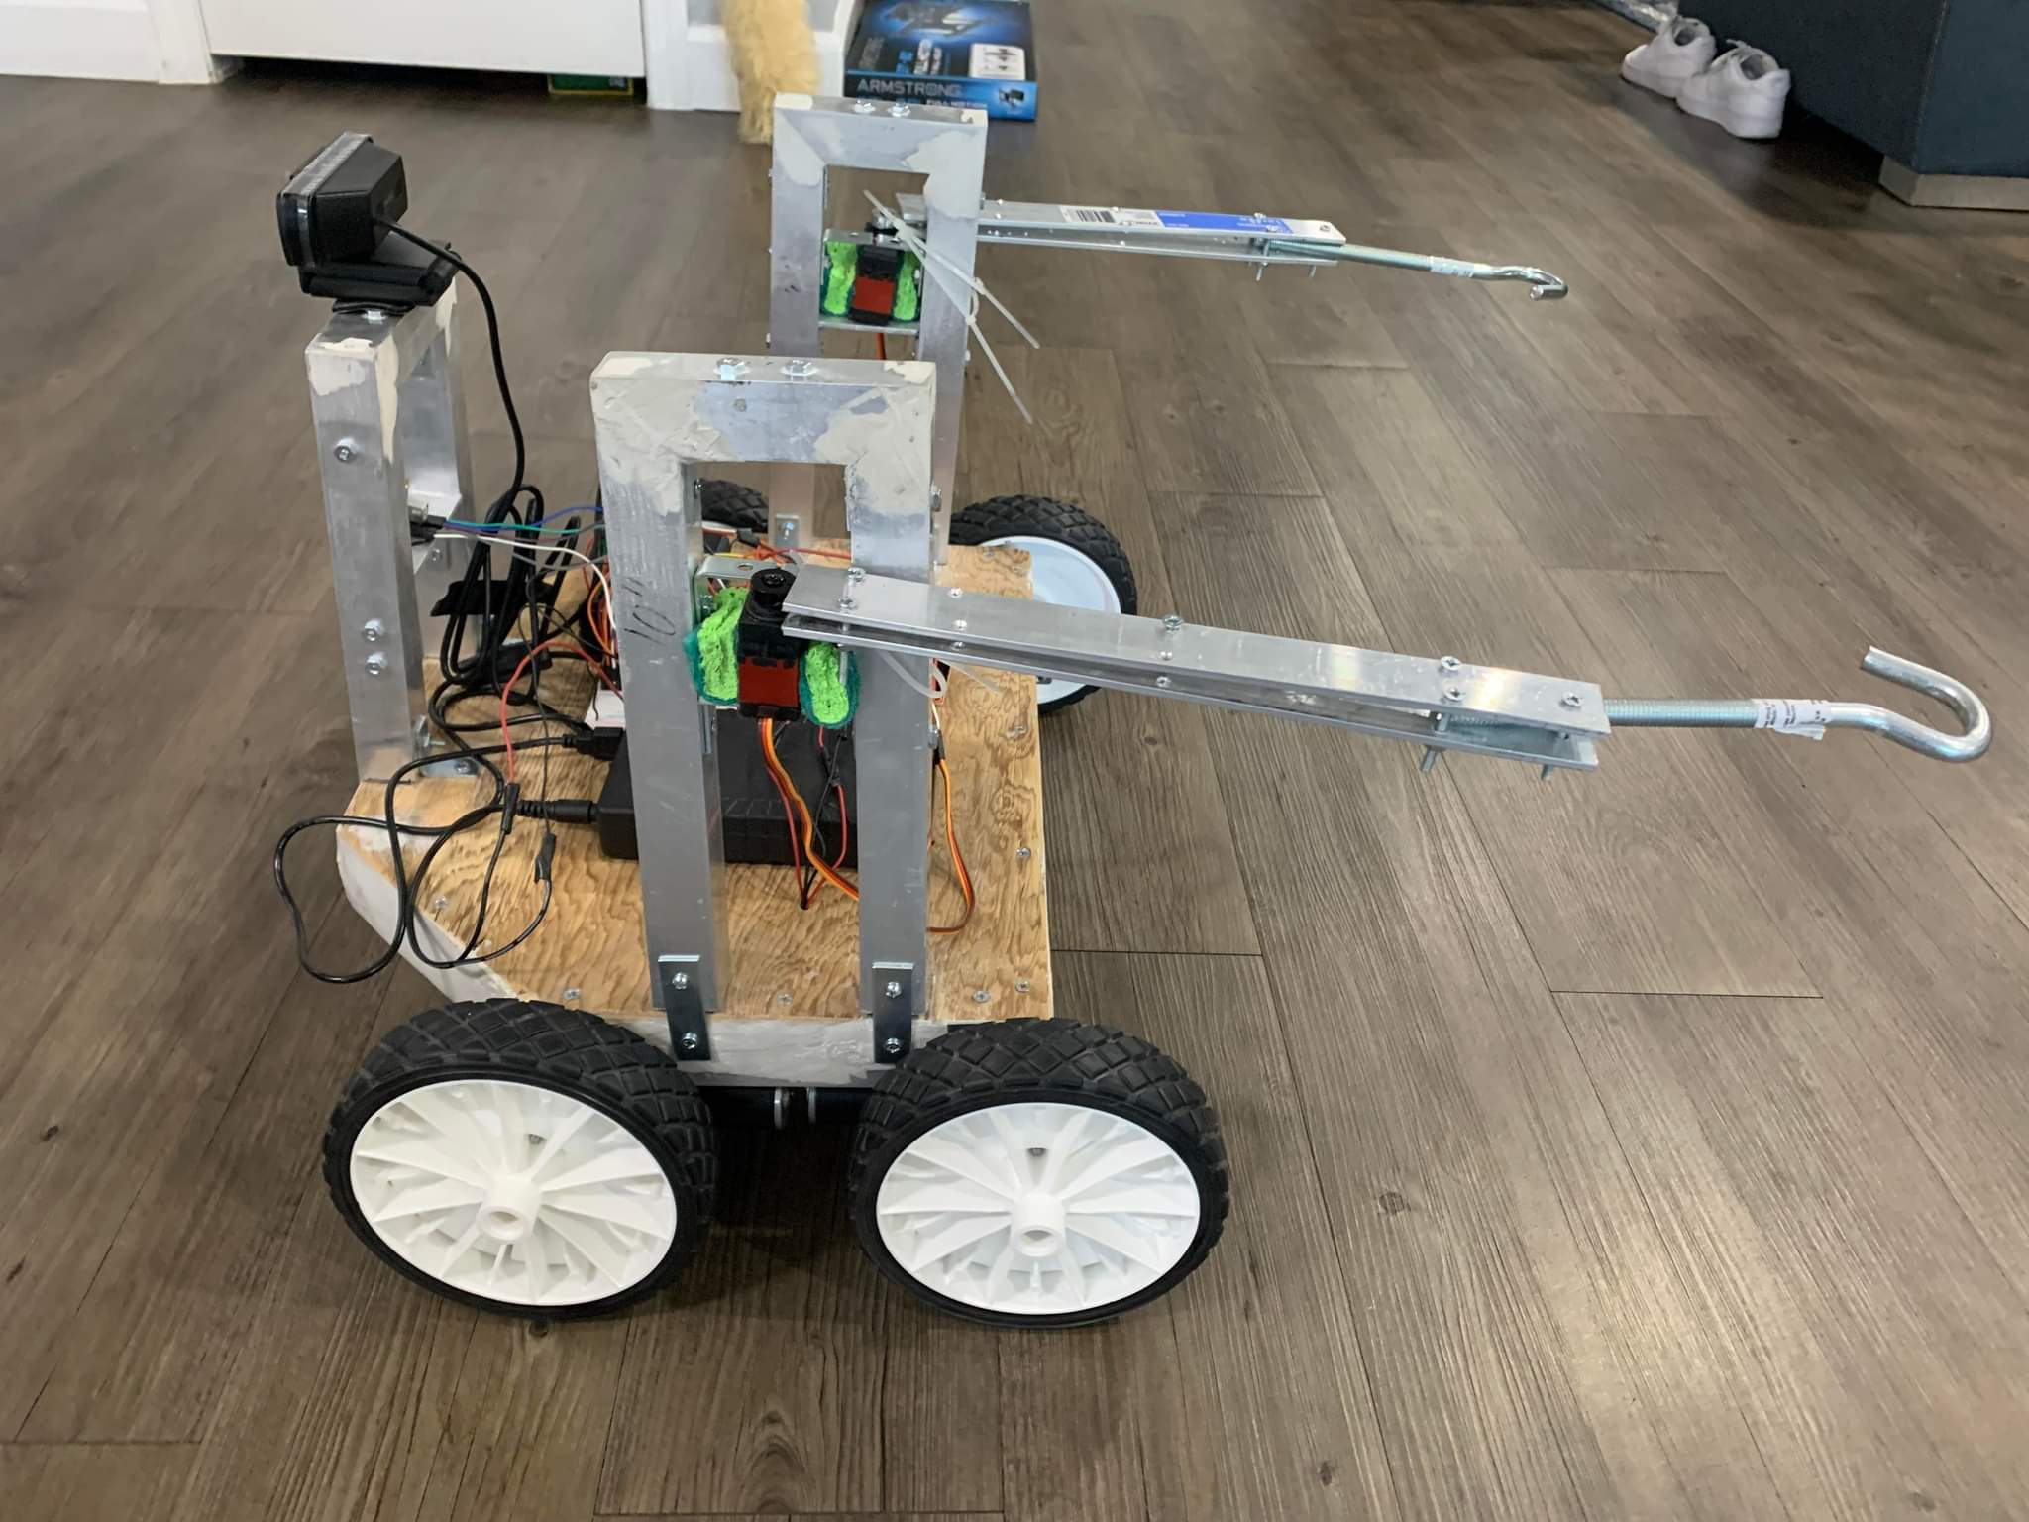
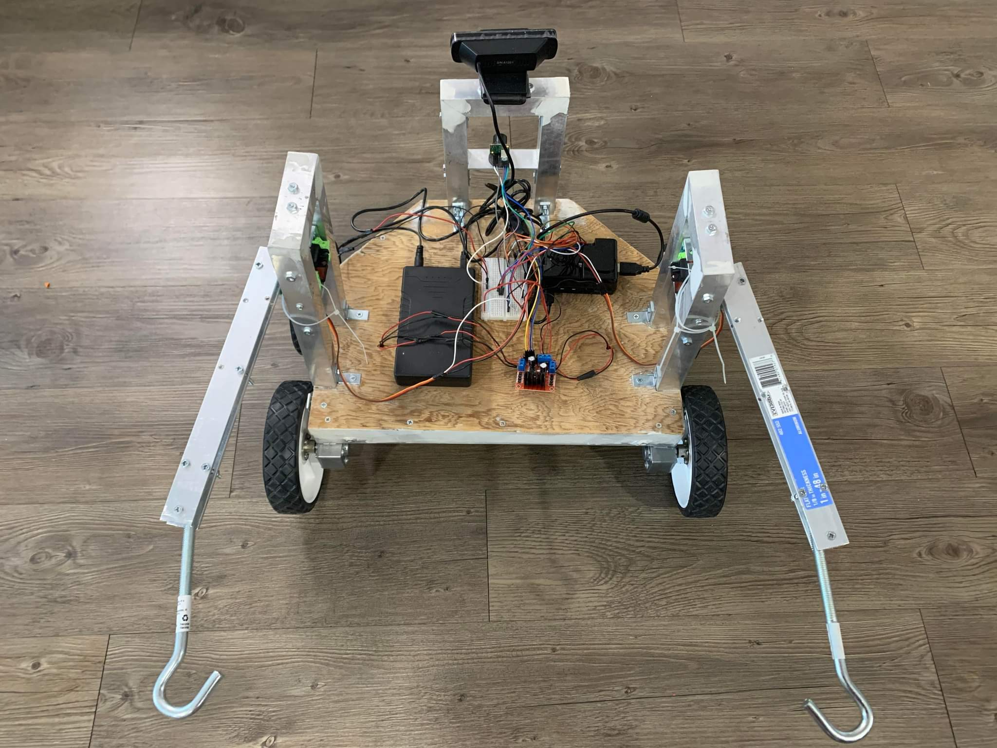
Final Prototype

Slide 13
Demo Video
https://drive.google.com/file/d/1Hdu9VvZYtWQrxZhjS39JovdiK2iOrwI7/view?usp=sharing

Slide 14
Future Improvements
Reduce overall robot weight with lighter materials
Stronger gear motors to improve retrieval speed and accuracy
Increased cam quality to improve object detection
Improved object detection accuracy by supplying algorithm with data from varying lighting conditions and camera angles
Finer movement controls allowing for precise turns and better obstacle avoidance
Optimizations to power draw in order to increase operation time and inclusion of additional components
Improve users' ability to easily switch out or replace robot components in the case of malfunction or damage
Improve GUI to include more movement options and generally make it more aesthetically pleasing

Slide 15
Conclusions
Although there are smart automatic wheelchairs, there are none that can be called to the user when the user is away from the chair. We seek to create a solution for the user to be able to call the wheelchair to themselves both manually and automatically. The bot we are making is separate from the chair. The cost of the bot will be significantly less than these smart automatic wheelchairs costing below $1,000. The bot will work with manual wheelchairs and will bring the chair to the user. If the user leaves their chair somewhere around the house the bot should be able to find and retrieve the chair. This is a better solution for people that can’t afford to buy an automatic chair or for people that already have a manual wheelchair and just need the functionality of calling their chair to themselves.

